Slide 1
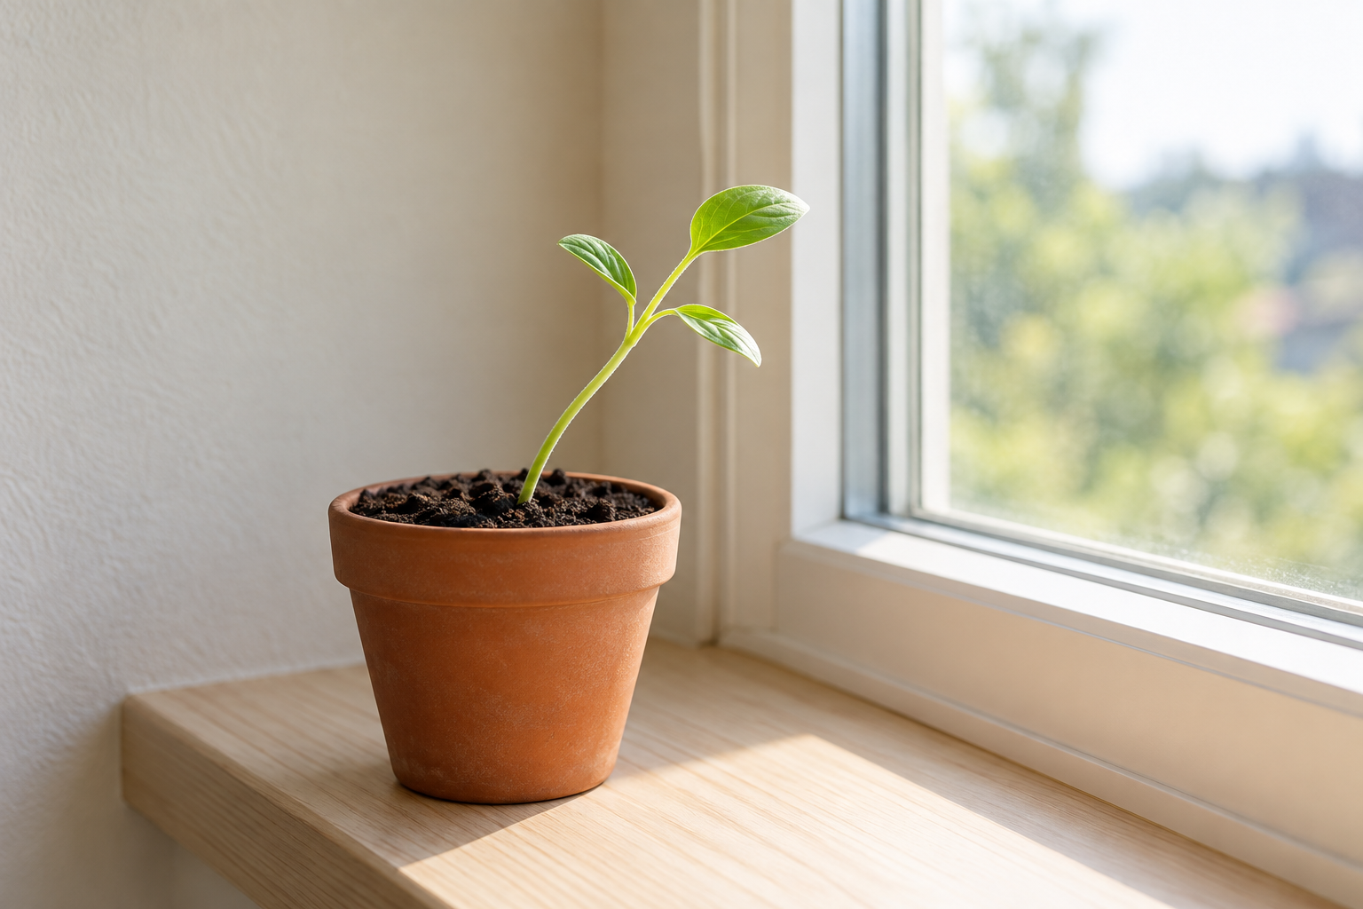
Observe the direction of growth
Direction matters here. Do not infer an experiment or a cause from one synthetic photo.

Slide 2
Set up an observation station
Identify the pot and its position before beginning a classroom observation.

Slide 3
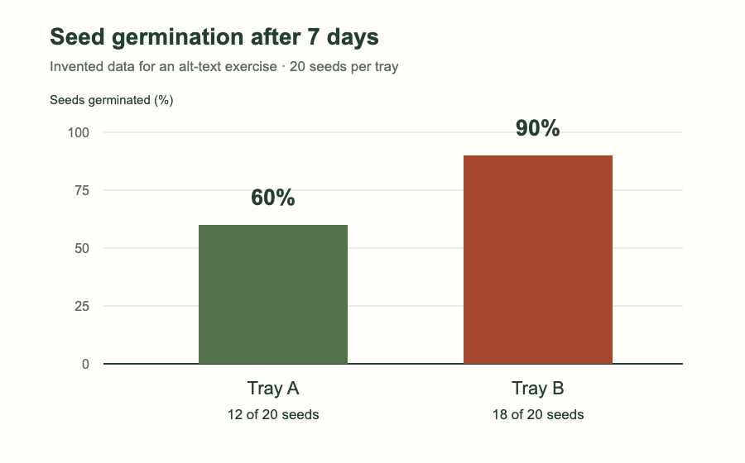
Compare two trays after 7 days
Invented practice data: Tray A, 12/20 (60%); Tray B, 18/20 (90%).

Slide 4
Observation station reminder
The same setup reminder and image purpose as slide 2.

Slide 5
Pause for a question
This image is deliberately decorative here and adds no information to this pause slide.

Slide 6
Native chart: work in PowerPoint
This native PowerPoint chart is outside the editor’s picture list. Review its data and accessibility in PowerPoint.

